Slide 1
Knowledge Management System for Manufacturing Plants in Macedonia and Absorption Capacity as Emerging Country
Betim Cico, Zamir Dika, Adrian Besimi, Haris Memeti
15th Workshop on Software Engineering Education and Reverse Engineering

Slide 2
OUTLINE
Introduction
Aims of Research
Hypothesis
Importance of Research
Significant prior of research
Research approach and methodology
Potential outcomes of research and importance
Conclusion

Slide 3
Introduction
Knowledge Management is a concept developed for capturing, developing also effectively using organizational knowledge.
Macedonia is an emerging country and has knowledge management importance.
Benefits and availability of Macedonia to adopt IT systems in knowledge management process and information sharing.

Slide 4
What is KM System ?
System to retrieve, collect and share information.
Uses knowledge for any purpose of an organization.
Enhances the cycle of KM by creating data, storing and mining repositories.
Used for better collaboration.

Slide 5
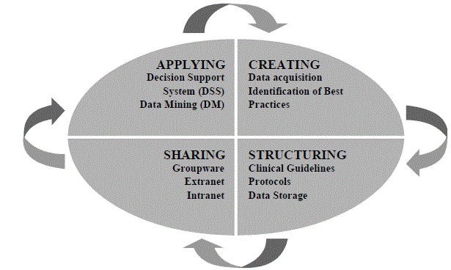

Slide 6
KM is all about making right decisions for a company.
Company uses KM to create strategies and tactics in systematic management of knowledge.
It helps to learn for old mistakes of a company.
It helps in the ability of a company to innovate on a specific field.

Slide 7
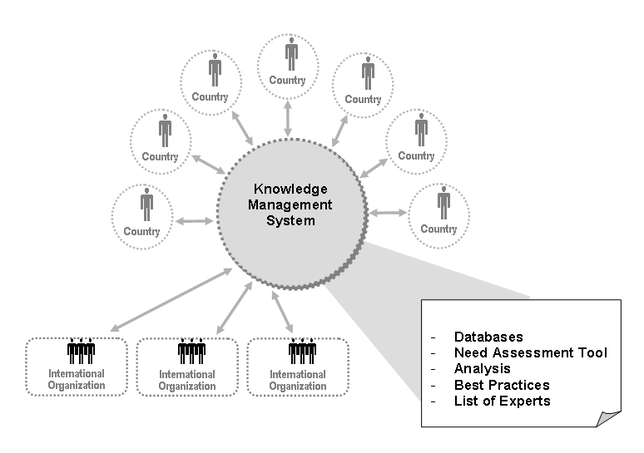

Slide 8
Why Macedonia ?
Cheap work force.
Young population as employee.
Close to European Countries.
Knowledge can be transferred easily.
Business process initiation is literally easy.

Slide 9
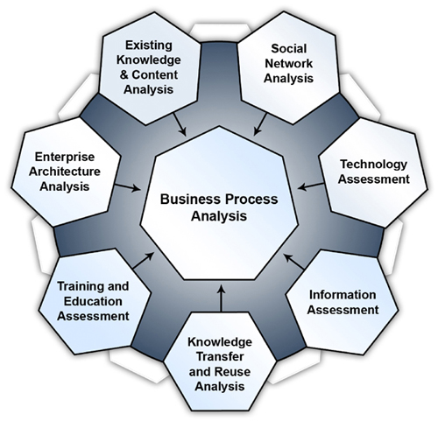

Slide 10
What is absorptive capacity ?
Ability of a company to recognize and act in the target of new information.
There are many models applied.
Absorptive capacity helps in performance and organizational learning of a company.

Slide 11
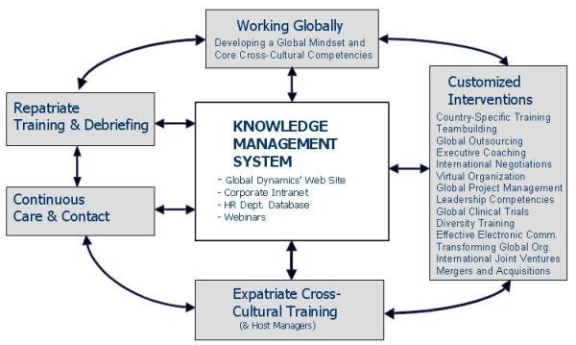

Slide 12
Aims of Research
Defining the level of absorptive capacity and knowledge transfer in emerging countries by using Information Technology.
Finding ways to increase knowledge transfer in emerging countries by using Information Systems.
Using IT to measure companies’ performance in emerging countries.

Slide 13
Research Field
Capability of emerging countries like Macedonia to absorb and transfer knowledge by means of Information Technology.
Impact of Information Technology in organizational structure for effectiveness.
Representation of knowledge transfer between developed and emerging countries.

Slide 14
Research Field
Interest of managers to apply new technologies for absorbing knowledge in emerging countries.
Investments in general on Information Technology.
Culture Influence in assumptions and decision making in Information Systems.

Slide 15
Hypothesis
Information technology will play an important role on recognizing new knowledge in Macedonia with any knowledge management system applied for a manufacturing plant.
Knowledge management system capability will increase the range of quality in manufacturing plants in Macedonia.
Absorption capacity would differ from country to country in the group of emerging countries.

Slide 16
Importance of Research
Information Systems usage and knowledge absorption in emerging countries.
Variety in the development and bringing new era in manufacturing plants in emerging countries.
Investment in ERP, Supply Chain Management and Total Quality Management.

Slide 17
Significant prior research
How many companies from developed countries have manufacturing plants in Macedonia?
Availability of companies in Macedonia to implement the needed technology
Level of education in emerging countries.

Slide 18
Research approach and methodology
Emerging countries and a relation with developing countries.
Questions to managers for improvement or difference in Information Systems.
Analysis of opening manufacturing plant in Macedonia, benefits etc.
Level of absorbance between emerging countries.

Slide 19
Potential outcomes and importance
Knowledge Management System may be useful tool for developing manufacturing process in Macedonia.
Information Technology would have a big contribution to make minor changes in absorbance.
Knowledge transferred and their representation is important.

Slide 20
Conclusion
Information system might bring lower level of knowledge absorption if not used properly.
Company can become bigger if has successful cycle of application of knowledge management system.
Performance of a company in developed country and emerging country in prospect of Information Technology

Slide 21
Bibliography
Nungpil Hahn and Mani R. Subramani. 2000. A framework of knowledge management systems: issues and challenges for theory and practice. In Proceedings of the twenty first international conference on Information systems (ICIS '00). Association for Information Systems, Atlanta, GA, USA, 302-312.
M. Lynne Markus, Cornelis Tanis, and Paul C. van Fenema. 2000. Enterprise resource planning: multisite ERP implementations. Commun. ACM 43, 4 (April 2000), 42-46
Cao, L., & Zhu, H. (2013). Normal accidents: data quality problems in ERP-enabled manufacturing. Journal of Data and Information Quality (JDIQ), 4(3), 11.
Shaul, L., & Tauber, D. (2013). Critical success factors in enterprise resource planning systems: Review of the last decade. ACM Computing Surveys (CSUR), 45(4), 55.
Shaul, L., & Tauber, D. (2013). Critical success factors in enterprise resource planning systems: Review of the last decade. ACM Computing Surveys (CSUR), 45(4), 55.
Gupta, A., & Seshasai, S. (2007). 24-hour knowledge factory: Using Internet technology to leverage spatial and temporal separations. ACM Transactions on Internet Technology (TOIT), 7(3), 14.

Slide 22
Thank you !
Questions…

